Slide 1

Day 2 Theme: CSS
Let’s make our website Beautiful.

Slide 2
Quick Recap!
What are HTML elements?
What are tags and their types?
What are elements?

Slide 3
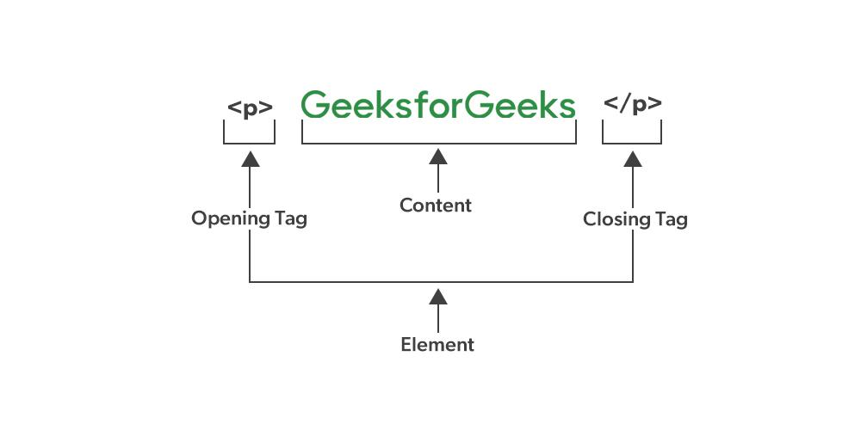

Slide 4
Key Concepts to Cover today:
What is CSS?
Inline vs Internal vs External CSS (focus on internal today)
CSS syntax: `selector { property: value; }`
How to apply colors, fonts, backgrounds, spacing, and layout
`class` and `id` attributes

Slide 5
